Slide 1
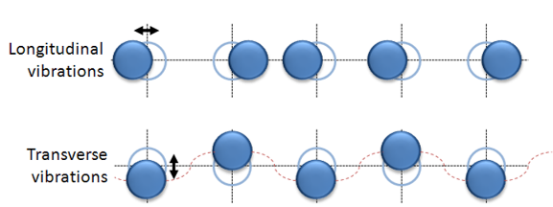
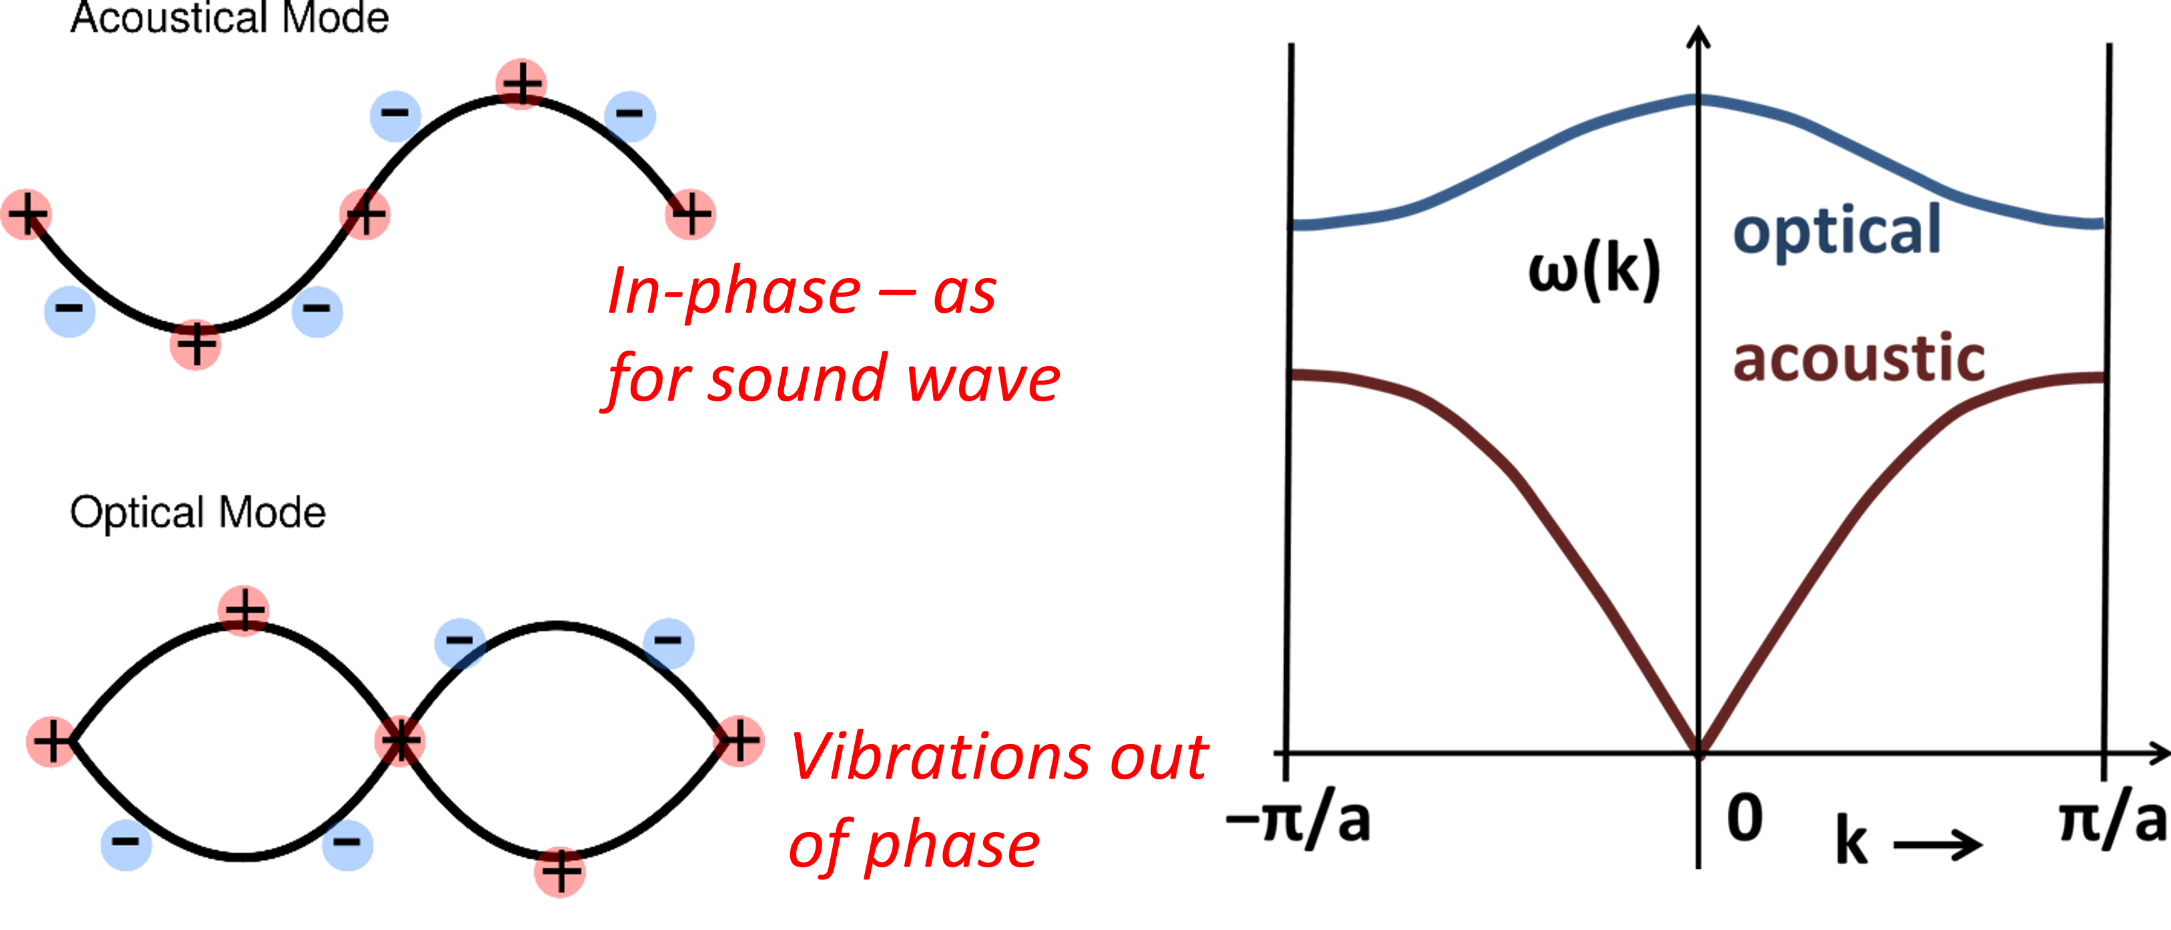
Chapter 9
Interaction of light with lattice vibrations
Phonon revision (look back at PH22006)
Coupling of light to optical phonons
Infrared reflectivity of insulators and semiconductors
y_{n-1}
x_{n}
y_{n}
x_{n+1}

Slide 2
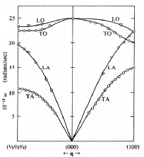
Chapter 9
Phonon dispersion curves
The direction of motion of the atoms compared to the wavevector can be LONGITUDINAL or TRANSVERSE and atoms within a unit cell can vibrate in phase (ACOUSTIC mode) or out of phase (OPTICAL mode) with each other. Modes are denoted as LA, TA, LO, TO.
In diamond the LO and TO phonons have
the same energy at q=0; need polar bonds
to remove the degeneracy. For the acoustic branch at small wavevectors the dispersion curve is linear:
where v_{s} is the velocity of sound.
DISPERSION CURVES FOR DIAMOND

Slide 3
Chapter 9
Infra-red active phonons
In an ionic solid positively charged atoms move in opposite direction to negatively charged ones in an optical mode, i.e. there is an oscillating dipole that can couple to an EM wave if the phonon is transverse. Polar TO phonons are said to be “IR active”
EM wave and vibrational wave must have the same frequency and momentum to couple.
The dispersion curves shows that this is only possible directly for the optical branch at wavevectors q ~0 (because ).
Dispersion of photon mode (exaggerated slope) compared to vibrational dispersion curves.
Fox, fig 10.2

Slide 4
Chapter 9
Lorentz oscillator model of driven lattice vibrations
Equations of motion for + and – ions in optical field E(t): need 2 equations now.
Q is effective ion charge, K is restoring force constant.
Dividing each equation by the relevant mass and subtracting them
from each other, we get
is the reduced ion mass

Slide 5
Chapter 9
Now change to use coordinate and introduce phonon damping constant (inverse of phonon lifetime of ~1-10 ps, caused by phonon-phonon scattering associated with anharmonicity of lattice vibrations).
(using results of atomic
oscillator model)
Hence
Rewrite as
high frequency (ω>>Ω_{TO}) static (ω=0)

Slide 6
Chapter 9
Note that for light damping
which has solution
is the condition for longitudinal EM waves to exist in materials
(lecture 8) so that ω’ can be identified with Ω_{LO}
The ratio of LO and TO frequencies is thus
(called the Lyddane Sachs Teller relation)

Slide 7
Chapter 9
CALCULATED INFRARED REFLECTIVITY OF POLAR CRYSTAL FOR VERY LIGHT DAMPING
This region is called the Reststrahlen (‘residual rays’) band
100% reflectivity between ν_{TO} and ν_{LO}.
Fox, Fig 10.4. ν_{TO} = 10 THz,
ν_{LO} = 11 THz, ε_{ST}=12.1 and ε∞=10.
Values close to many important
semiconductors e.g. GaAs

Slide 8
Chapter 9
Infrared Reflectivity of some real polar crystals
Experimental data shows that the reflectivity is high between the LO and TO frequencies but is less than 100%
because there is damping of the resonance.
The damping also softens the edges of the resonance.
The infrared transmission dip due to TO phonon absorption can be seen in the spectra for sapphire and CdSe, earlier.
IR reflectivity of InAs and GaAs at 4.2 K: Fox, fig 10.5

